Slide 1
Introduction to Python
Web Development
Django Web Framework

Slide 2
Web Framework
Designed to simplify web development
To save you from re-inventing the wheel
Provides libraries for accessing database, creating templates to display your HTML or even as complex as Content Management System

Slide 3
Django Framework
Django is a high-level Python Web framework that encourages rapid development and clean, pragmatic design. Built by experienced developers, it takes care of much of the hassle of Web development, so you can focus on writing your app without needing to reinvent the wheel. It’s free and open source.
  Ridiculously fast.
    Django was designed to help developers take applications from concept to completion as quickly as possible.
  Reassuringly secure.
    Django takes security seriously and helps developers avoid many common security mistakes.
  Exceedingly scalable.
    Some of the busiest sites on the Web leverage Django’s ability to quickly and flexibly scale.

Slide 4
MVC Concept
Model
  Handles your data representation
View
  Represents what you see in a browser
Controller
  Controls the flow of information between the Model and the View

Slide 5
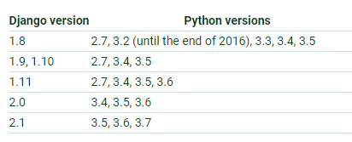
Python-Django Versions

Slide 6
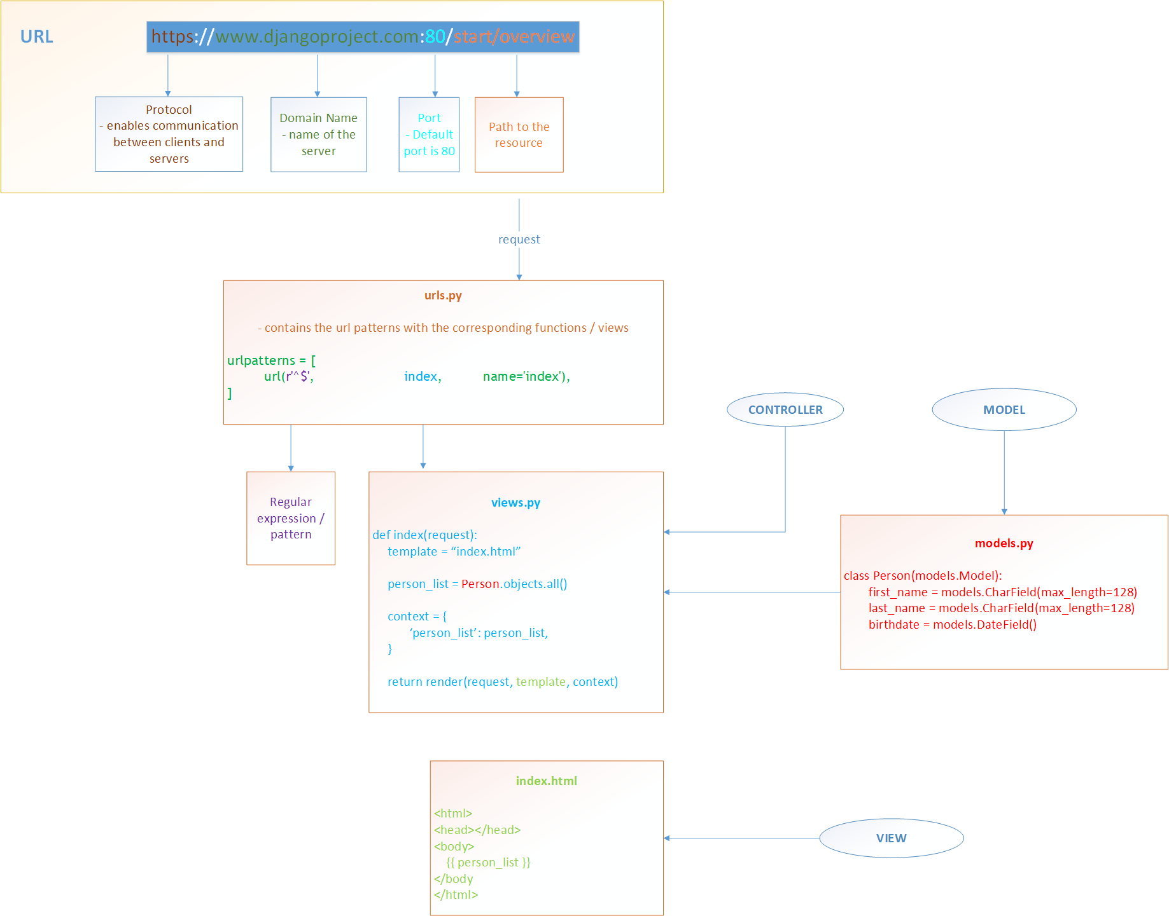
Django MVC Concept

Slide 7
Django MTV
Model Model
Template View
View Controller

Slide 8
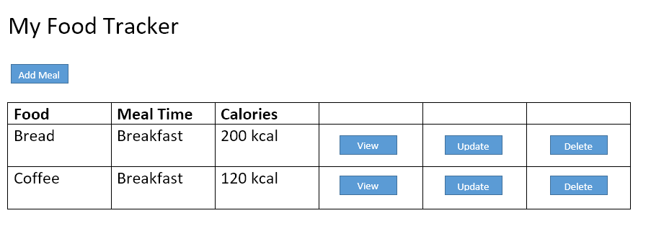
Creating a Web Application (My Food Tracker)

Slide 9
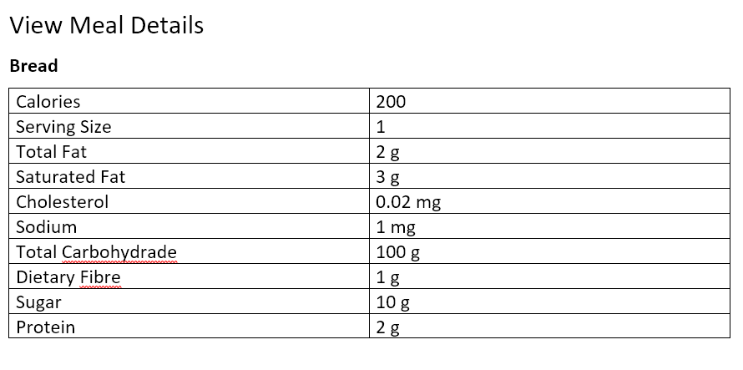
Creating a Web Application (My Food Tracker)

Slide 10
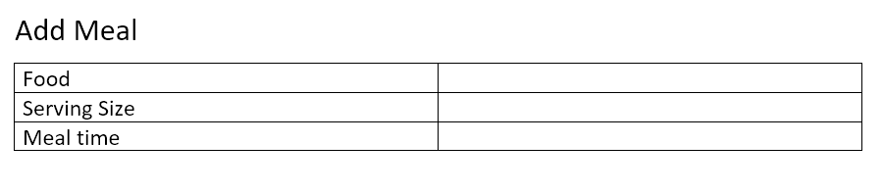
Creating a Web Application (My Food Tracker)

Slide 11
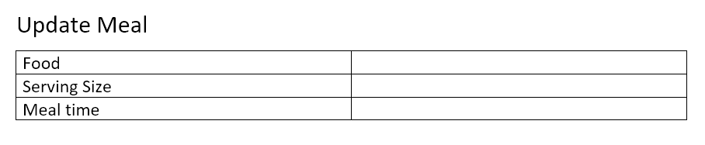
Creating a Web Application (My Food Tracker)

Slide 12
Prerequisites
Python
Pip
Virtualenv
Django

Slide 13
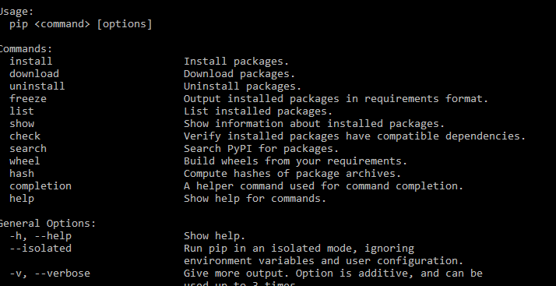
Prerequisites
Check if Pip is installed
Pip
pip

Slide 14
Prerequisites
Install pip
pip is already installed if you are using Python 2 >=2.7.9 or Python 3 >=3.4 downloaded from python.org
To install pip:
  Download get-pip.py to a folder on your computer. Open a command prompt window and navigate to the folder containing get-pip.py. Then run python get-pip.py.

Slide 15
Prerequisites
Install Virtualenv
Create Virtualenv
pip install virtualenv
virtualenv food_tracker_env

Slide 16
Prerequisites
Run Virtualenv
Exit from the env directory before executing startproject. Do not save the project inside the env directory.
food_tracker_env\Scripts\activate

Slide 17
Prerequisites
Install Django
pip install Django==2.2

Slide 18
Creating a Project
Start Django project
django-admin startproject food_tracker

Slide 19
Creating a Project
Start Django project
food_tracker/
manage.py
food_tracker /
__init__.py
settings.py
urls.py
wsgi.py

Slide 20
Creating a Project
Django Project files
The outer food_tracker/ root directory is just a container for your project. Its name doesn’t matter to Django; you can rename it to anything you like.
manage.py: A command-line utility that lets you interact with this Django project in various ways. You can read all the details about manage.py in django-admin and manage.py.
The inner food_tracker/ directory is the actual Python package for your project. Its name is the Python package name you’ll need to use to import anything inside it (e.g. food_tracker.urls).

Slide 21
Creating a Project
Django Project files
food_tracker/__init__.py: An empty file that tells Python that this directory should be considered a Python package.
food_tracker/settings.py: Settings/configuration for this Django project. Django settings will tell you all about how settings work.

Slide 22
Creating a Project
Django Project files
food_tracker /urls.py: The URL declarations for this Django project; a “table of contents” of your Django-powered site.
food_tracker/wsgi.py: An entry-point for WSGI-compatible web servers to serve your project.

Slide 23
Running the Project
Runserver
python manage.py runserver

Slide 24
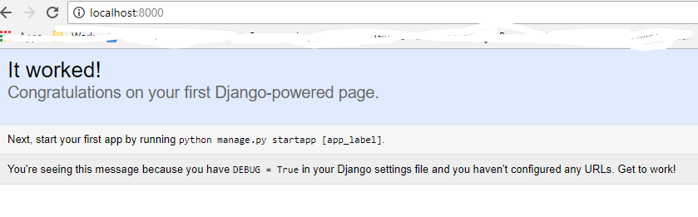
Running the Project
Runserver

Slide 25
Starting an app
cd to food_tracker
python manage.py startapp food

Slide 26
Starting an app
App is equivalent to Module in Django
food_tracker/
manage.py
food_tracker /
__init__.py
settings.py
urls.py
wsgi.py
food/
__init__.py
admin.py
apps.py
migrations/
__init__.py
models.py
tests.py
views.py

Slide 27
Writing your first View
food_tracker/food/views.py
from django.http import HttpResponse
def index(request):
return HttpResponse("Hello, world. You're at the index page.")

Slide 28
Writing your first View
food_tracker/food/urls.py
from django.conf.urls import url
from .views import *
urlpatterns = [
url(r'^$', views.index, name='index'),
]

Slide 29
Writing your first View
Register app url to the main url
food_tracker/food_tracker/urls.py
from django.conf.urls import include, url
from django.contrib import admin
urlpatterns = [
url(r'^', include(('food.urls’,’food’), namespace="food")),
url(r'^admin/', admin.site.urls),
]

Slide 30
Urls Regular Expression
http://example.com/food
url pattern
Commonly used Regular Expressions:
- attendance - specific string
- $ - end of pattern
- (?P<attendance_id>\d+) - accepts integer (any len)
- (?P<year>[0-9]{4}) - accepts char w/ values 0-9, len 4
- (?P<name>\w+) - accepts string any len

Slide 31
Database Setup
food_tracker/food_tracker/settings.py
ENGINE – Either 'django.db.backends.sqlite3', 'django.db.backends.postgresql', 'django.db.backends.mysql', or 'django.db.backends.oracle'. Other backends are also available.
NAME – The name of your database. If you’re using SQLite, the database will be a file on your computer; in that case, NAME should be the full absolute path, including filename, of that file. The default value, os.path.join(BASE_DIR, 'db.sqlite3'), will store the file in your project directory.

Slide 32
Database Setup
Install DB Sqlite
http://sqlitebrowser.org/

Slide 33
Applications Setup
food_tracker/settings.py
By default, INSTALLED_APPS contains the following apps, all of which come with Django:
django.contrib.admin – The admin site. You’ll use it shortly.
django.contrib.auth – An authentication system.
django.contrib.contenttypes – A framework for content types.
django.contrib.sessions – A session framework.
django.contrib.messages – A messaging framework.
django.contrib.staticfiles – A framework for managing static files.

Slide 34
Migration
Update/Create database
python manage.py migrate

Slide 35
Creating Models
food_tracker/food/models.py
from django.db import models
class Food(models.Model):
name = models.CharField(verbose_name="Food Name", max_length=200)
calories = models.FloatField(verbose_name="Calories (kcal)")
total_fat = models.FloatField(verbose_name="Total Fat (g)")
saturated_fat = models.FloatField(verbose_name="Saturated Fat (g)")

Slide 36
Creating Models
food_tracker/food/models.py
from django.db import models
class Meal(models.Model):
BREAKFAST = 1
LUNCH = 2
MEAL_TIME_TYPES = (
(BREAKFAST, "Breakfast"),
(LUNCH, "Lunch")
)
food = models.ForeignKey(Food, verbose_name="Food”,on_delete = models.CASCADE)
serving_size = models.IntegerField(verbose_name="Serving Size")
meal_time = models.IntegerField(verbose_name="Meal Time", choices=MEAL_TIME_TYPES)

Slide 37
Declaring apps
food_tracker/food_tracker/settings.py
INSTALLED_APPS = [
'django.contrib.admin',
'django.contrib.auth',
'django.contrib.contenttypes',
'django.contrib.sessions',
'django.contrib.messages',
'django.contrib.staticfiles',
'food',
]

Slide 38
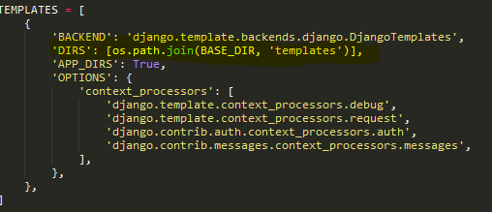
Configure templates directory
food_tracker/food_tracker/settings.py
TEMPLATES["DIRS"] = [os.path.join(BASE_DIR, 'templates')]
Create templates folder

Slide 39
Updating Database
Make Migration and Migrate
python manage.py makemigrations food
python manage.py migrate

Slide 40
Using Manage.py Shell
python manage.py shell
>>> from food.models import Food
>>> food = Food()
>>> food.name = “Bread”
>>> food.calories = 50
>>> food.total_fat = 0

Slide 41
Create
python manage.py shell
>>> from food.models import Food
>>> food = Food()
>>> food.name = “Bread”
>>> food.calories = 50
>>> food.total_fat = 0
>>> …
>>> food.save()

Slide 42
Queries and Filters
python manage.py shell
>>> from food.models import Food
>>> foods = Food.objects.all()
>>> food_1 = Food.objects.get(id=1)
>>> food_bread = Food.objects.filter(name__iexact=“Bread”) # Case insensitive
>>> food_bread_exact = Food.objects.filter(name__exact=“Bread”) # Case sensitive
>>> food_bread_substring = Food.objects.filter(name__icontains=“B”) # Case insensitive Substring

Slide 43
Update
python manage.py shell
>>> from food.models import Food
>>> food_1 = Food.objects.get(id=1)
>>> food_1.name = “Tinapay”
>>> food_1.save()

Slide 44
Delete
python manage.py shell
>>> from food.models import Food
>>> food_1 = Food.objects.get(id=1)
>>> food_1.delete()

Slide 45
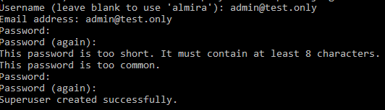
Django Admin
Creating an admin user
python manage.py createsuperuser

Slide 46
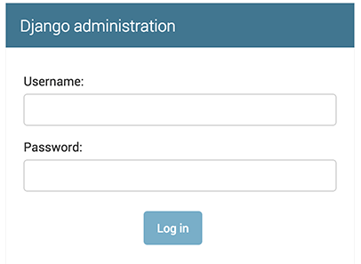
Django Admin
Runserver
Go to 127.0.0.1:8000/admin
python manage.py runserver

Slide 47
Register Model
food_tracker/food/admin.py
from .models import Food, Meal
admin.site.register(Food)
admin.site.register(Meal)

Slide 48
Index Page

Slide 49
Writing Index View
food_tracker/food/views.py
from django.shortcuts import render
from .models import Food, Meal
def index(request):
template = 'list.html'
meals = Meal.objects.all()
context = {
'meals': meals,
}
return render(request, template, context)

Slide 50
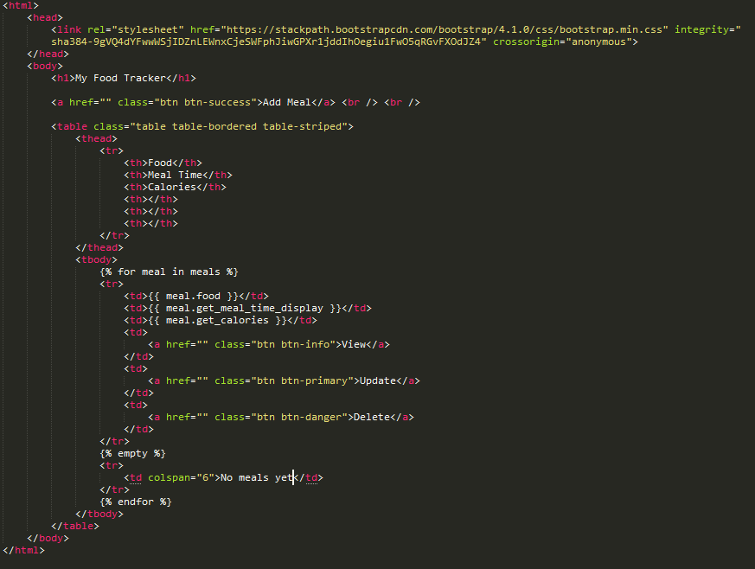
Writing Index Template
food_tracker/templates/list.html

Slide 51
Writing Index URLs
food_tracker/food/urls.py
from django.conf.urls import url
from .views import index
urlpatterns = [
url(r'^$', index, name='index'),
]

Slide 52
Add Meal Page

Slide 53
Writing forms
Create forms.py inside food_tracker/food/
from django import forms
from .models import Meal
class MealForm(forms.ModelForm):
class Meta:
model = Meal
fields = "__all__"

Slide 54
Add meal View
Import MealForm to views.py and create function for the add meal
from django.http import HttpResponseRedirect
from django.urls import reverse_lazy
from .forms import MealForm
def add_meal(request):
template = "add_meal.html"
if request.method == "POST":
form = MealForm(request.POST)
if form.is_valid():
form.save()
return HttpResponseRedirect(reverse_lazy('food:index'))
else:
context = {
'meal_form': MealForm(),
}
return render(request, template, context)

Slide 55
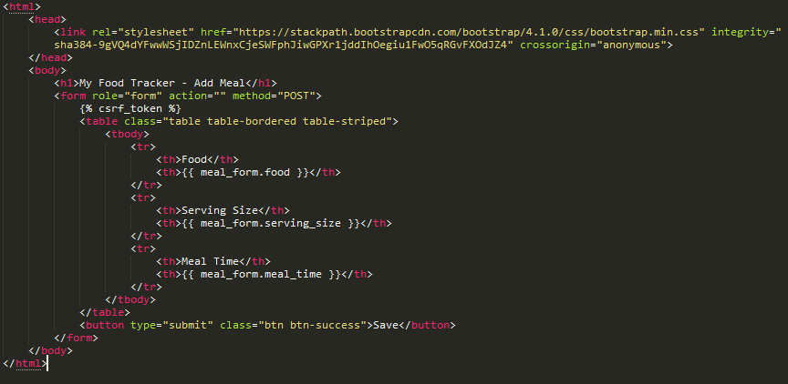
Add meal Template
Create add_meal.html

Slide 56
Register add_meal to urls.py
food_tracker/food/urls.py
from django.conf.urls import url
from .views import index, add_meal
urlpatterns = [
url(r'^$', index, name='index'),
url(r'^add_meal$', add_meal, name='add-meal'),
]

Slide 57
Delete meal View
def delete_meal(request, meal_id):
meal = Meal.objects.get(id=int(meal_id))
meal.delete()
return HttpResponseRedirect(reverse_lazy('food:index'))

Slide 58
Register delete_meal to urls.py
food_tracker/food/urls.py
from django.conf.urls import url
from .views import index, add_meal, delete_meal
urlpatterns = [
url(r'^$', index, name='index'),
url(r'^add_meal$', add_meal, name='add-meal'),
url(r'^delete_meal/(?P<meal_id>\d+)$', delete_meal, name='delete-meal'),
]

Slide 59
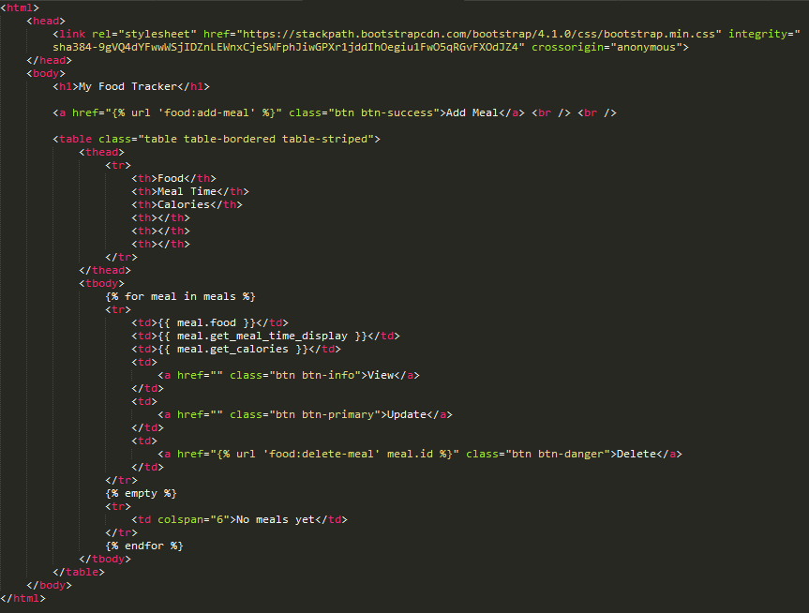
Add "delete meal" url to list.html

Slide 60
Update Meal Page

Slide 61
Update meal View
from django.http import HttpResponseRedirect
from django.urls import reverse_lazy
def update_meal(request, meal_id):
template = "update_meal.html"
meal = Meal.objects.get(id=int(meal_id))
if request.method == "POST":
form = MealForm(request.POST, instance=meal)
if form.is_valid():
form.save()
return HttpResponseRedirect(reverse_lazy('food:index'))
else:
context = {
'meal_form': MealForm(instance=meal),
}
return render(request, template, context)

Slide 62

Update meal Template
Create update_meal.html

Slide 63
Register update_meal to urls.py
food_tracker/food/urls.py
from django.conf.urls import url
from .views import index, add_meal, delete_meal, update_meal
urlpatterns = [
url(r'^$', index, name='index'),
url(r'^add_meal$', add_meal, name='add-meal'),
url(r'^delete_meal/(?P<meal_id>\d+)$', delete_meal, name='delete-meal'),
url(r'^update_meal/(?P<meal_id>\d+)$', update_meal, name='update-meal'),
]

Slide 64
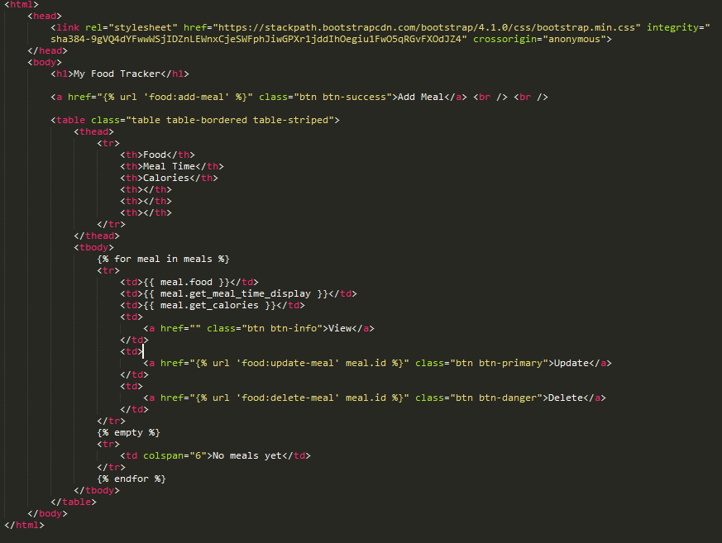
Add "update meal" url to list.html

Slide 65
Mini Exercise
Create "View" button which displays nutritional facts (i.e. Food Name, Calories, Total Fat etc.)

Slide 66
Mini Exercise
Create "View" button which displays nutritional facts (i.e. Food Name, Calories, Total Fat etc.)

Slide 67
Copy code
HTML HEAD
<head>
<link rel="stylesheet" href="https://stackpath.bootstrapcdn.com/bootstrap/4.1.0/css/bootstrap.min.css" integrity="sha384-9gVQ4dYFwwWSjIDZnLEWnxCjeSWFphJiwGPXr1jddIhOegiu1FwO5qRGvFXOdJZ4" crossorigin="anonymous">
</head>

Slide 68
Copy Code
Food Model
class Food(models.Model):
name = models.CharField(verbose_name="Name", max_length=128)
calories = models.FloatField(verbose_name="Calories (kcal)")
total_fat = models.FloatField(verbose_name="Total Fat (g)")
saturated_fat = models.FloatField(verbose_name="Saturated Fat (g)")
cholesterol = models.FloatField(verbose_name="Cholesterol (mg)")
sodium = models.FloatField(verbose_name="Sodium (mg)")
total_carbohydrate = models.FloatField(verbose_name="Total Carbohydrate (g)")
dietary_fibre = models.FloatField(verbose_name="Dietary Fibre (g)")
sugar = models.FloatField(verbose_name="Sugar (g)")
protein = models.FloatField(verbose_name="Protein (g)")
def __str__(self):
return "%s" % self.name

Slide 69
Copy Code
Meal Model
class Meal(models.Model):
BREAKFAST = 1
MORNING_SNACK = 2
LUNCH = 3
AFTERNOON_SNACK = 4
DINNER = 5
EVENING_SNACK = 6
MEAL_TIME_TYPES = (
(BREAKFAST, "Breakfast"),
(MORNING_SNACK, "Morning Snack"),
(LUNCH, "Lunch"),
(AFTERNOON_SNACK, "Afternoon Snack"),
(DINNER, "Dinner"),
(EVENING_SNACK, "Evening Snack")
)
food = models.ForeignKey(Food, verbose_name="Food" , on_delete = models.CASCADE)
serving_size = models.IntegerField(verbose_name="Serving Size")
meal_time = models.IntegerField(verbose_name="Meal Time", choices=MEAL_TIME_TYPES)
def __str__(self):
return "%s" % self.food

Slide 70
Final Project
Create a Blog Application that contains the following:
  List of Blog Posts
  Add Blog Posts
  View Individual Blog Posts
  Can add and delete comments to Blog Post
  Update Existing Blog Posts
  Presentation: November 30, 2019

